Slide 1

Understanding the Importance of Data
Welcome to the workshop on "Unlocking the Power of Data: A Hands-on Workshop on Free Tools for Statistical Analysis".
In today's world, every industry relies on data to make informed decisions.
This workshop aims to help you understand the importance of data analysis and how free tools can unlock insights into your data.
Gideon Alake

Slide 2
The Goals of the Workshop
2. Gain Insights
Uncover hidden patterns and trends in data using free tools
1
2
3
1. Understand the Basics
3. Make Better Decisions
Learn what free tools are available for analyzing data
Turn insights into actions with informed
decision-making using free data tools

Slide 3




Data in Different Industries
Healthcare Industry
Manufacturing Industry
Finance Industry
Social Media Industry
Data enables better patient care and assists in the development of new treatments and therapies.
Data is essential in monitoring production processes and identifying opportunities for improvement and waste reduction.
Data helps financial companies analyze market trends and make informed decisions about investments and trading strategies.
Data drives the development of new features and algorithms that improve user engagement and personalization.

Slide 4
The Power of Data Analysis
1. Identify Opportunities
2. Measure Success
3. Improve Efficiency
Discover potential areas of growth or improvement
Track key performance indicators and metrics
Streamline processes and reduce waste
4. Enhance Decision-Making
Make informed decisions based on data and insights

Slide 5
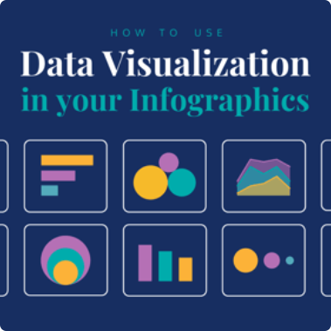


What Data Analysis Can Do for You
Visualize Your Data
Gain Competitive Advantages
Automate Your Analysis
Turn numbers into clear and informative visualizations.
Identify market trends and stay ahead of the competition.
Use software tools to simplify your analysis and save time.

Slide 6

What Data Analysis Cannot Do
1
Fix data from a poorly conducted experiment
2
‘Cure’ all your
analytical need
Data analysis tools do not have a mind of their own. They do not replace critical thinking and decision-making process during experimental set-up.
Although data analysis can provide insights, it is still data that require various forms of manipulation before it can be useful for analytics. Each analytical need may require certain data features.

Slide 7
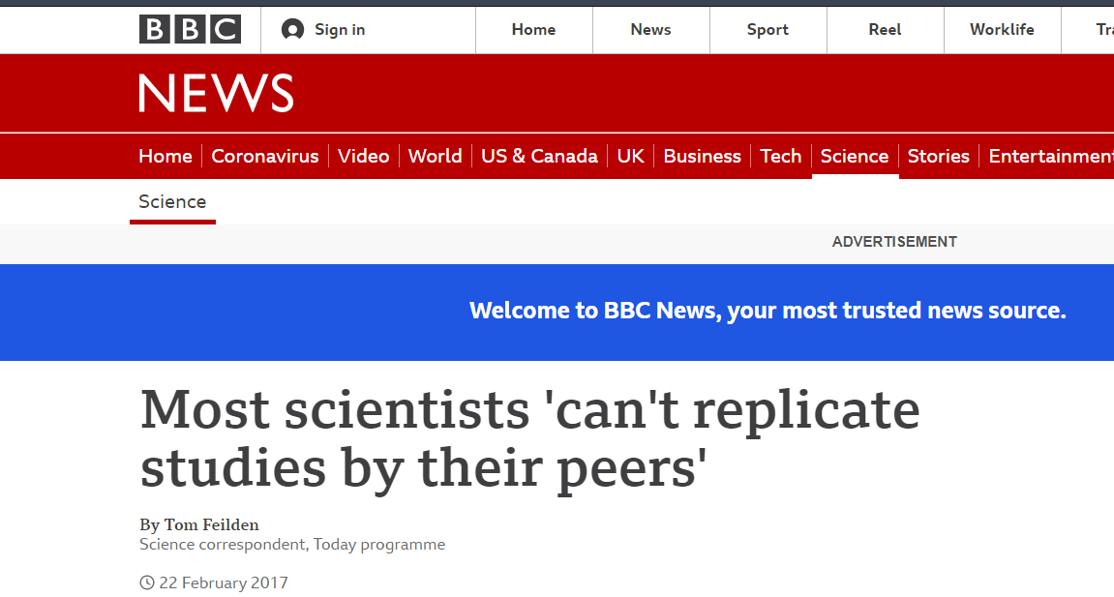
“REPRODUCIBILITY CRISIS”
Up to 2/3 of researchers have tried and failed to reproduce another scientist’s experiments
"Replication is something scientists should be thinking about before they write the paper" - Ritu Dhand, Editorial director at Nature.

Slide 8
The Process of Data Analysis
1
1. Define Your Question
Identify the problem you want to solve or decision you want to make.
2
2. Collect Your Data
Obtain and organize the data you need for your analysis.
3
3. Clean and Process Your Data
Remove inconsistencies, outliers and duplicates from your data to ensure accuracy.
4
4. Analyze Your Data
Apply statistical methods and models to your data.

Slide 9
The Process of Data Analysis
5
5. Communicate Your Findings
Present your results clearly and effectively to stakeholders.
6
6. Take Action
Use your findings to make informed decisions and take action.

Slide 10
Data Analysis Tools and Techniques
Tools
Techniques
Excel (pivot tables, charts, regression analysis)
Hypothesis Testing
R and Python (programming languages for data analysis)
Regression Analysis and Machine Learning
Tableau and PowerBI (data visualization software)
Cluster Analysis and Segmentation

Slide 11
Common Data Analysis Challenges
Data Quality
Data Security
Data Volume
Data that is incomplete, inaccurate or irrelevant can lead to faulty analysis and wrong conclusions.
Data breaches and cyberattacks can lead to loss of sensitive information and damage to reputation.
Large amounts of data can be difficult to manage and analyze efficiently.
Data Integration
Integrating data from multiple sources can be challenging and time-consuming.

Slide 12

Data Analysis Best Practices
1
Define Your Objectives
2
Use a Structured Process
3
Document Your Methodology
Clarify the problem you're trying to solve and what insights you hope to gain from the analysis.
Follow a structured process to ensure accuracy and consistency in your analysis.
Record your process, assumptions, and decisions to ensure transparency and reproducibility.
4
Leverage Automation
Use software tools to automate your analysis and reduce the risk of human error.

Slide 13
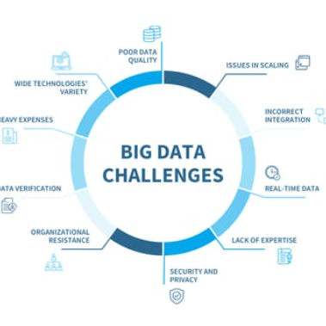


The Future of Data Analysis
Big Data
Artificial Intelligence
Internet of Things
Analysis of large and complex data sets using advanced technologies and machine learning.
Analysis and decision-making using algorithms and AI-based systems.
Data collection and analysis from interconnected devices and systems.

Slide 14
The Power of Data
Data = Insights
Data = Competitive Advantage
Data = Innovation
Unlock valuable insights and drive better decision-making with effective data analysis.
Use data to identify new opportunities and innovate with data-driven solutions.
Gain a competitive edge by using data to inform your strategy and stay ahead of the curve.

